Slide 1

Using GitHub.com to Manage Your Scholarly Work
Brian Zelip, bzelip@hshsl.umaryland.edu Emerging Technologies Librarian

Slide 2
This workshop’s agenda
Brief tour of GitHub and create free account
Learn the core concepts of GitHub
Practice using GitHub

Slide 3

Open GitHub.com

Slide 4
“Nature journals have required that authors declare the location of any custom code and software central to the main claims in a paper. [...] We recommend hosting source code on GitHub.”
- “Rebooting review”. Nature Biotechnology 33, 319 (2015). doi:10.1038/nbt.3202

Slide 5
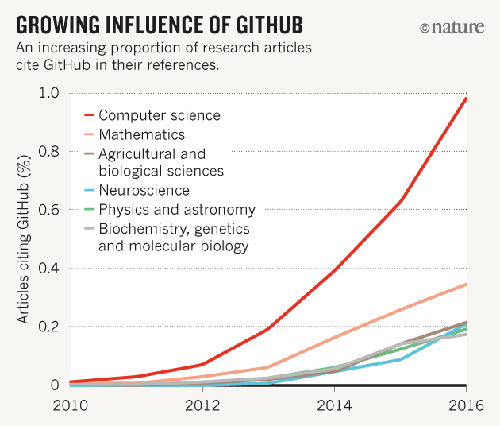
Source: “Democratic databases: science on GitHub”. Nature 538, 127-128 (06 October 2016). doi:10.1038/538127a

Slide 6
GitHub is:
Version control system
Data sharing tool
Collaboration tool
Discovery tool
Free web hosting service

Slide 7
Key GitHub concepts
Repository = individual project workspace/directory/folder

Slide 8
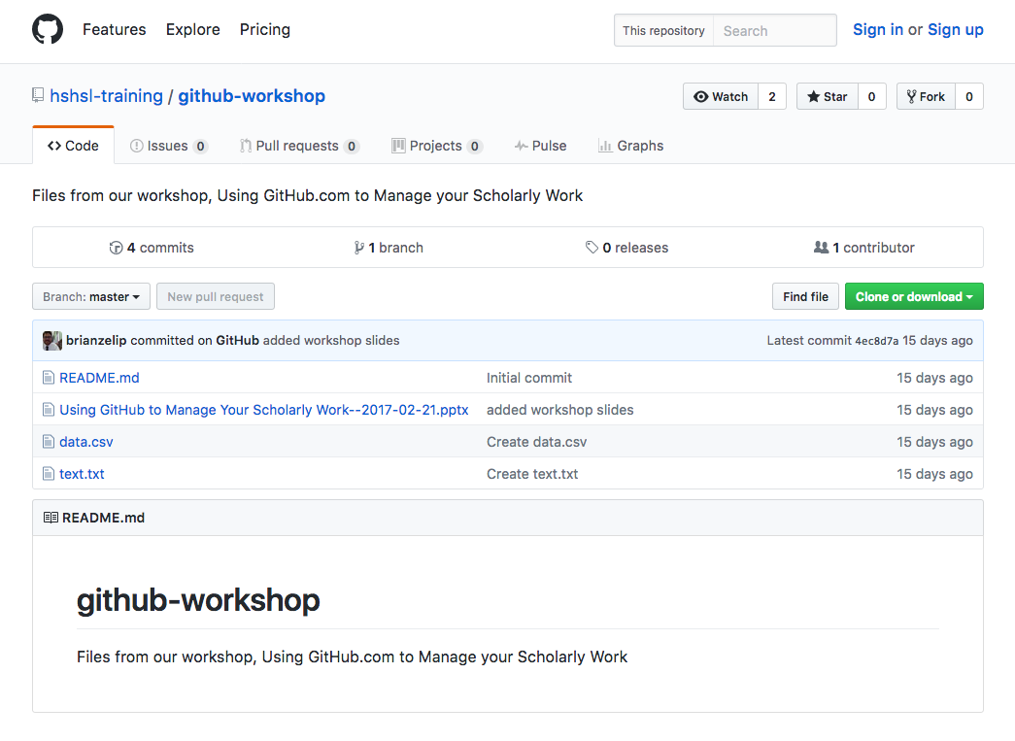
The “github-workshop” repository owned by the user “hshsl-training”

Slide 9
Key GitHub concepts
Repository = individual project workspace/directory/folder
Clone or Fork = copy a repository

Slide 10
The “Clone” and “Fork” buttons

Slide 11
Key GitHub concepts
Repository = individual project workspace/directory/folder
Clone or Fork = copy a repository
Commit = save a version of a repository

Slide 12
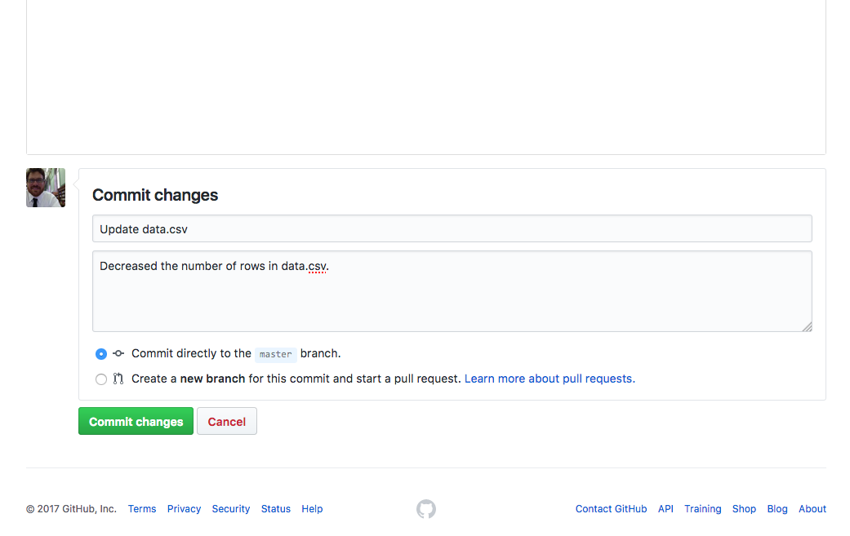
The “commit” section when updating a file from the GitHub website

Slide 13
Key GitHub concepts
Repository = individual project workspace/directory/folder
Clone or Fork = copy a repository
Commit = save a version of a repository
Commit message = description of the commit

Slide 14
The short and long “commit message” fields from the GitHub website

Slide 15
Key GitHub concepts
Repository = individual project workspace/directory/folder
Clone or Fork = copy a repository
Commit = save a version of a repository
Commit message = description of the commit
Issues = discussion space for a repository

Slide 16
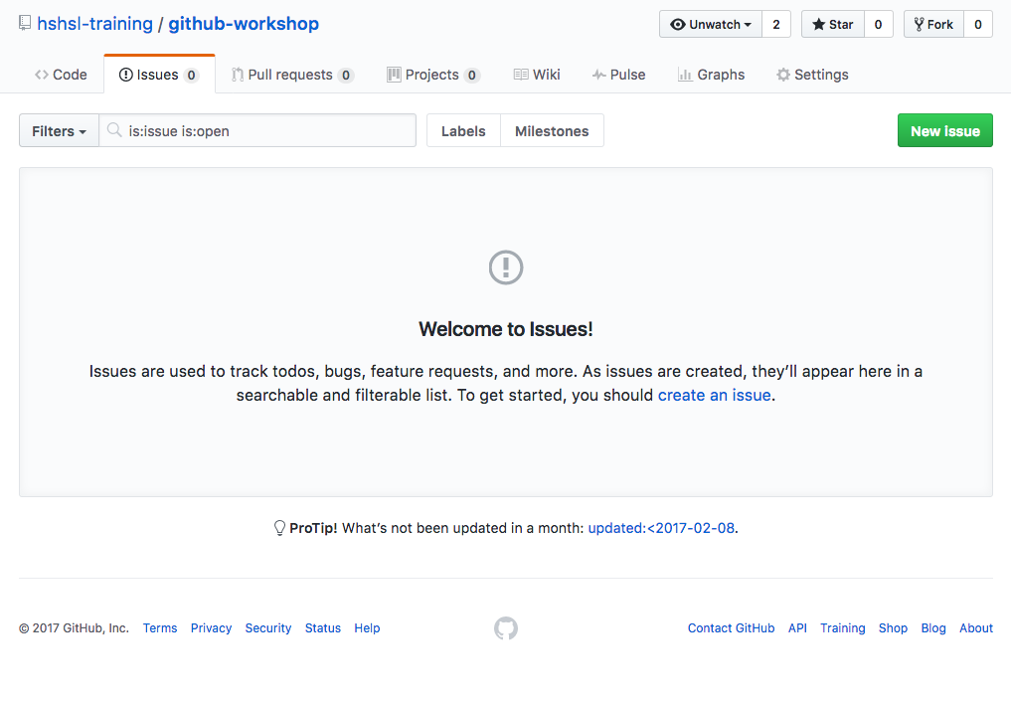
The “Issues” tab inside a repository

Slide 17
Key GitHub concepts
Repository = individual project workspace/directory/folder
Clone or Fork = copy a repository
Commit = save a version of a repository
Commit message = description of the commit
Issues = discussion space for a repository
Pull request = a change to a repository offered from an outside author

Slide 18
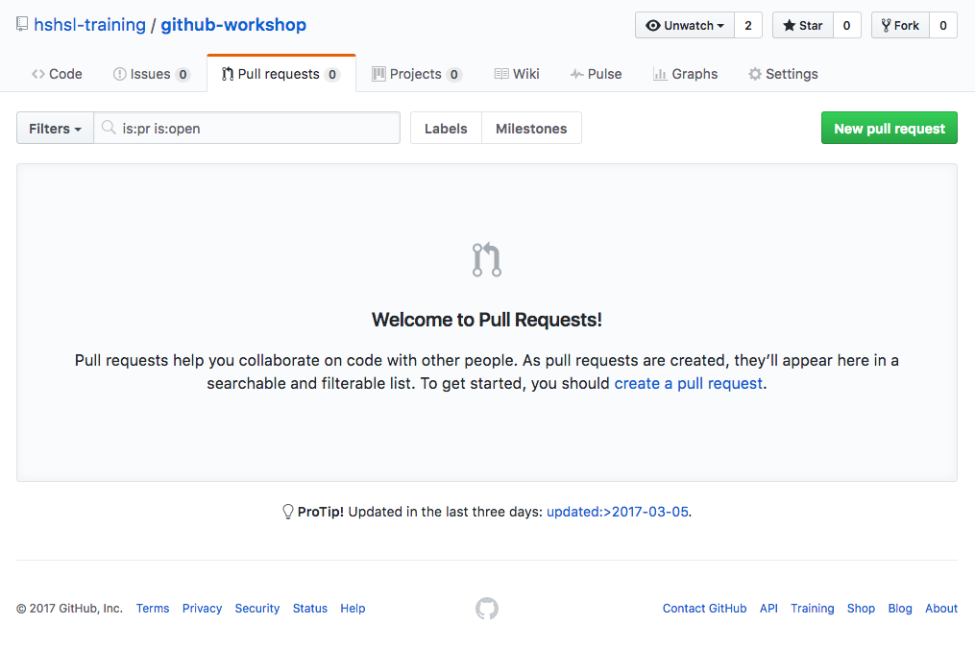
The “Pull requests” tab inside a repository

Slide 19
Key GitHub concepts
Repository = individual project workspace/directory/folder
Clone or Fork = copy a repository
Commit = save a version of a repository
Commit message = description of the commit
Issues = discussion space for a repository
Pull request = a change to a repository offered from an outside author
Branch = a sandbox version of a repository for experimentation

Slide 20
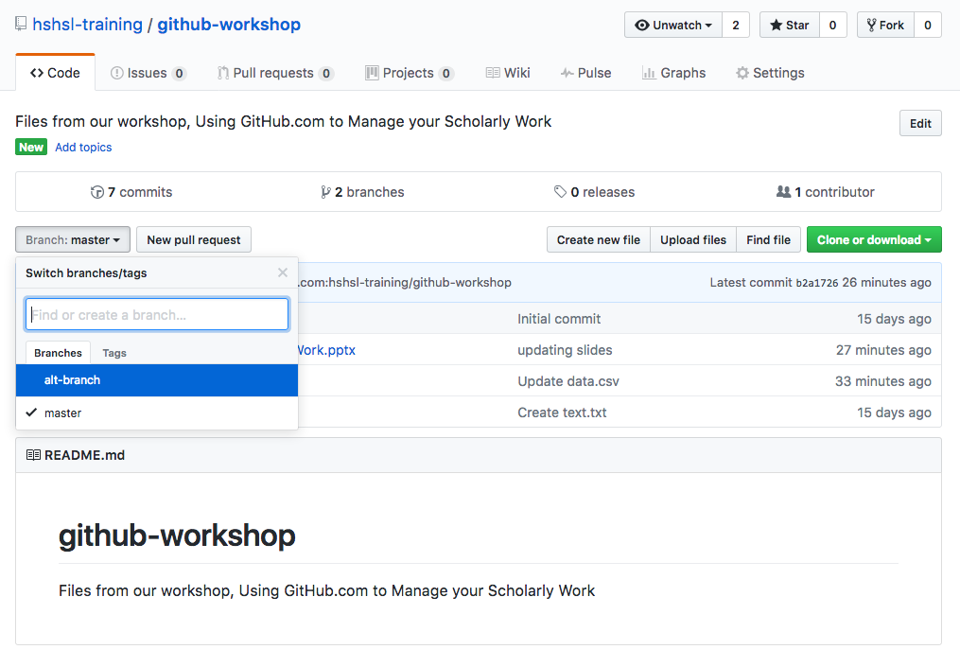
The “Branch” menu inside a repository; “master” branch is currently checked

Slide 21
There are 3 ways to access GitHub?
Via github.com
Via GitHub Desktop App, desktop.github.com
Via your computer’s command line interface

Slide 22
Resources
GitHub FAQ https://help.github.com
GitHub Guides https://guides.github.com
GitHub video tutorials https://www.youtube.com/user/GitHubGuides
GitHub Pages (the free web hosting part of GitHub) https://pages.github.com
Git documentation http://www.git-scm.com/doc

Slide 23
Open GitHub.com

